Slide 1


Organizational Behavior
(MGT-502)
Lecture-10

Slide 2
Summary of
Lecture-9

Slide 3
What Are Emotions?
Affect
A broad range of emotions that people experience.
Emotions
Intense feelings that are directed at someone or something.
Moods
Feelings that tend to be less intense than emotions and that lack a contextual stimulus.

Slide 4
Felt versus Displayed Emotions
Felt emotions
An individual’s actual emotions.
Displayed emotions
Emotions that are organizationally
required and considered appropriate
in a given job.

Slide 5
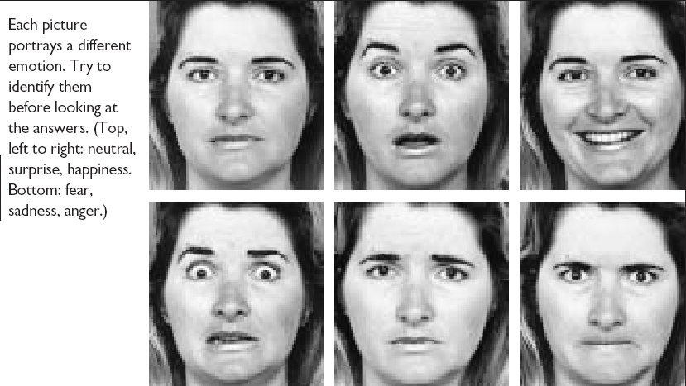
Facial Expressions Convey Emotions

Slide 6
Today’s Topics

Slide 7
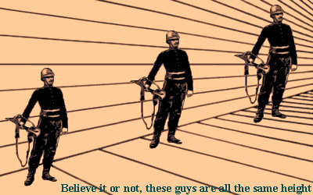
Individual Behavior-Perception

Slide 8
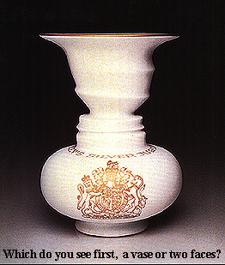
Perception

Slide 9
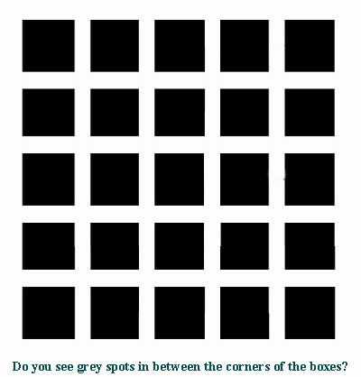
Perception

Slide 10
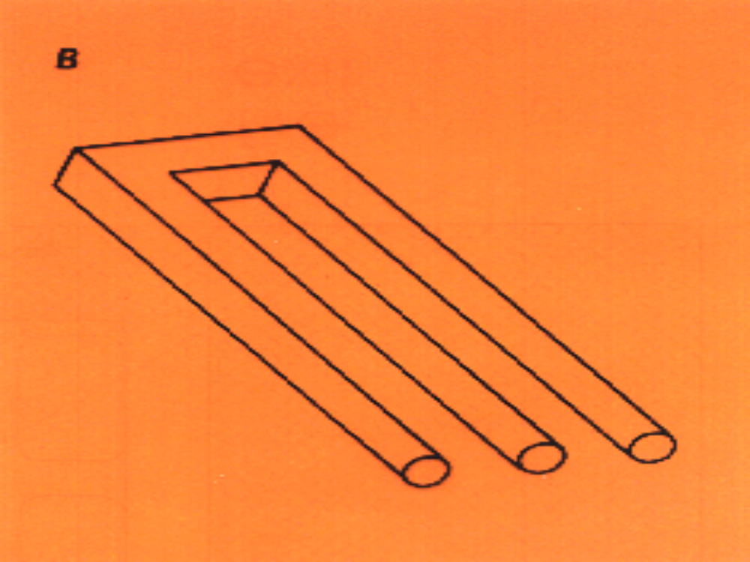

Slide 11
Perception

Slide 12

Perception

Slide 13
What is Perception?
  A process by which individuals organize and interpret their sensory impressions in order to give meaning to their environment.
Why Is it Important?
  Because people’s behavior is based on their perception of what reality is, not on reality itself.
  The world that is perceived is the world that is behaviorally important.

Slide 14
Basic Elements in the Perceptual Process
Observation
* Taste * Smell
* Hearing * Sight
* Touch
Environmental
Stimuli
Perceptual Selection
* External factors
* Internal factors
Perceptual
Organization
* Perceptual grouping
Interpretation
* Perceptual errors
* Attributions
Response

Slide 15
Perceptual process model
Environmental stimuli
Feeling Hearing Seeing Smelling Tasting
Selective attention
Organisation and
interpretation
Emotions and
behaviour

Slide 16
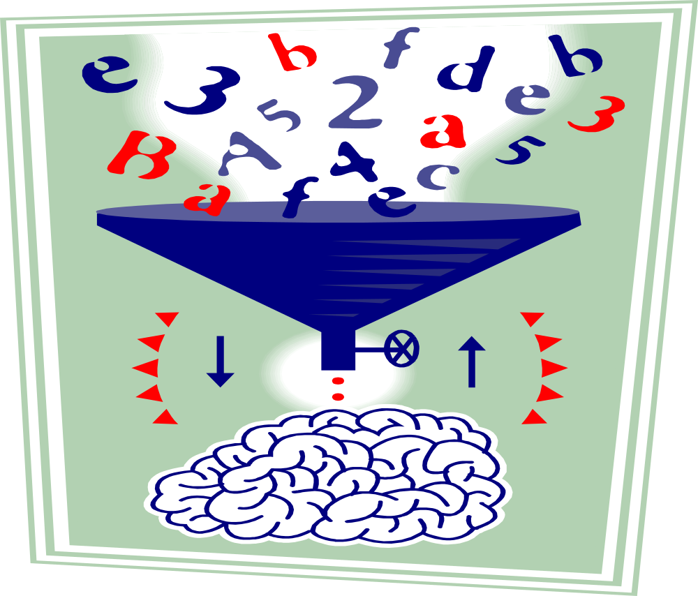

Slide 17
Points about Perception
Perception is the process by which you give meaning to your environment by organizing & interpreting stimuli into a psychological experience.
Because perception varies across individuals, people see the same thing in different ways.

Slide 18

In the eye of the beholder
Process of response to environmental stimuli
  Selection
  Organization
No two people will necessarily perceive situation the same
Individuals base behavior on perceived reality

Slide 19
Perception
A cognitive process: lets a person make sense of stimuli from the environment
Affects all senses: sight, touch, taste, smell, hearing
Includes inputs to person and choice of inputs to which the person attends
Stimulus sources: people, events, physical objects, ideas
Helps adaptation to a changing environment

Slide 20
Factors Influencing Perception
The Perceiver
The Target
The Situation

Slide 21
Factors that Influence Perception
Factors in the Perceiver
  Attitudes
  Motives
  Interests
  Experience
  Expectations
Factors in the situation
  Time
  Work setting
  Social setting
Perception
Factors in the target
  Novelty
  Motion
  Sounds
  Size
  Background
  Proximity

Slide 22
Perceptual Selection
Filtering process so we can focus only on important stimuli
Depends on 2 major factors
  External environment
  Internal to the one perceiving

Slide 23
External Factors
size
Intensity (brightness, loudness, etc)
Contrast
Motion
Repetition- Repetition- Repetition-
Novelty/Familiarity

Slide 24
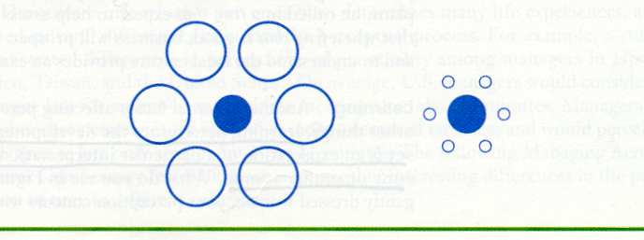
Contrast Effect

Slide 25
Internal Factors
Personality – Person Perception
Learning
  Perceptual Set
Motivation
  Inner needs

Slide 26
Social Perception
The process through which individuals attempt to combine, integrate, and interpret information about others.

Slide 27
Social Perception
Social Perception -
interpreting information about another person
Notes:
19
19

Slide 28
Social Perception
Social Perception -
interpreting information about another person
Perceiver Characteristics
Familiarity with target
Attitudes/Mood
Self-Concept
Cognitive structure
Notes:
20
20

Slide 29
Social Perception
Social Perception -
interpreting information about another person
Perceiver Characteristics
Familiarity with target
Attitudes/Mood
Self-Concept
Cognitive structure
Target Characteristics
Physical appearance
Verbal communication
Nonverbal cues
Intentions
Notes:
21
21

Slide 30
Social Perception
Social Perception -
interpreting information about another person
Perceiver Characteristics
Familiarity with target
Attitudes/Mood
Self-Concept
Cognitive structure
Target Characteristics
Physical appearance
Verbal communication
Nonverbal cues
Intentions
Situational Characteristics
Interaction context
Strength of situational cues
Notes:
22
22

Slide 31
Barriers to Social Perception
Selective perception
Stereotyping
First-impression error
The halo effect
Social Perception -
interpreting information about another person
Notes:
23
23

Slide 32
Overcoming Bias in Social Perception
Do not overlook the external causes of others behavior
Identify and confront your stereotypes
Evaluate people based on objective factors
Avoid making rash judgment

Slide 33

Let’s stop it here

Slide 34
Summary

Slide 35
What is Perception?
  A process by which individuals organize and interpret their sensory impressions in order to give meaning to their environment.
Why Is it Important?
  Because people’s behavior is based on their perception of what reality is, not on reality itself.
  The world that is perceived is the world that is behaviorally important.

Slide 36
Factors Influencing Perception
The Perceiver
The Target
The Situation

Slide 37
Factors that Influence Perception
Factors in the Perceiver
  Attitudes
  Motives
  Interests
  Experience
  Expectations
Factors in the situation
  Time
  Work setting
  Social setting
Perception
Factors in the target
  Novelty
  Motion
  Sounds
  Size
  Background
  Proximity

Slide 38
Next….

Slide 39
Organizational Behavior
(MGT-502)
Lecture-10

